Slide 1

Causal Digital Twin Factory

Slide 2

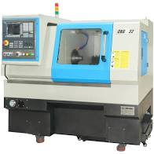
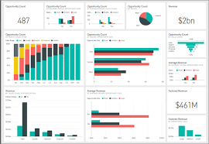
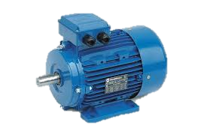


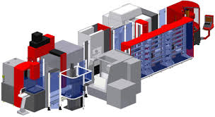
AI framework for IoT . . . Digital Twin
Physical Twin
Digital Twin
Home of -
Visualization
Machine Learning
Analytics

Slide 3
Many Twins . . .

Slide 4
SIMULATION Digital Twin . . .
Adjust NPSS params
till
“measurements” match!
1000’s of parameters in NPSS!
MANUALLY tweaking them till Measurements match is INTRACTABLE!
USE Machine Learning to do it!
“INVERSE Model” DT

Slide 5
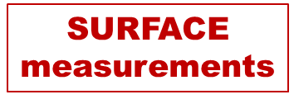

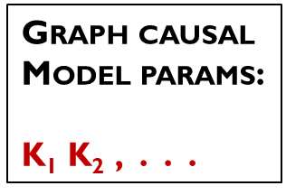
CAUSAL Digital Twin

Slide 6
The Problem . . . KINK in the IoT growth curve

Slide 7

CAUSAL Digital Twin FACTORY: 2-sided Marketplace
CDT Factory
(2-sided Marketplace)
Store inverse model DT (IM-DT)
Many machines & models
Develop new IM-DTs
Service Offerings:
Host IM-DT instances for OEMs
“Blind” aggregation across OEMs for benchmarking
Advisory for Opex reduction by prescriptive analytics
Manufacturing
OEMs
Factory
OPERATORS

Slide 8
CDT Factory VALUE PROPOSITION
Machinery OEMs:
Factory Operators:
Get access to patented “What-If” DT
Focus on YOUR roadmap – CDT Factory will take the “bleeding edge” technology RISK
Avoid/ minimize pre-standardization issues – CDT Factory maintains Display, Simulation & What-If Digital Twin for machine types
Avoid the hassle of YOU instantiating each machine serial # on factory floor
Help IoT ecosystem BYPASS the “Trough of Disillusionment!”
Reduce opex and increase throughput.
Prescriptive Analytics recommendations with gains and risks quantified.
Improve quality in-situ.
LONG-term (20 years?) of library storage of your machine DTs
Achieve PRECISION manufacturing!
CDT Factory Revenue Sources:
One-time machine Instantiation charge.
Library storage charge (10 to 20 years)
Performance service recommendations (INCREASES in out-years).
ISVs’ SaaS revenue share for CDT Factory platform use.

Slide 9
CDT Factory Business Stack
OEMs place their Display & Sim DTs on the Stack.
  3rd party DTs can also be placed.
OEMs engage to develop IM-DTs for their machinery categories.
Develop IM-DTs for OEMs & Factories
Instantiates each machine (serial #) & store them long-term.
Provides a “what-if” analysis SaaS service for machine owners.
OEMs, IT Service companies and Startups create Apps and Services on the Stack for sale to Factories and other customers.

Slide 10
CDT Factory – BRIEF Financials . . .
Income:
      TBD
  Recurring Revenue stream from service biz:
    Machine Instantiation charge
    Library storage charge
    Performance service recommendations
    ISVs’ SaaS revenue share for CDT Factory platform use
Expense - steady-state year:
    Office & equipment: $0.5MM per year
    IT expenses: $1MM per year
    Salaries + Incentives of Principals (3): $1MM per year
    Staff headcount (15): $3MM per year
TOTAL = $5.5MM per year
PG provides What-If DT patent license (3-year free & exclusive to CDT Factory)
After Year 3, ASSIGN patent to CDT Factory for upfront fee (no royalties) OR patent term changes to non-exclusive & non-transferable license

Slide 11
CAUSAL Digital Twin FACTORY Business Model Canvas
INVESRE MODEL Digital Twin: From IoT field measurements, estimate causal relationship parameters inside machines
Problem: Display DT cannot quantify causality. Many machine manufacturers and no standards. Prescriptive analytics is NOT possible today. Inverse Model DT (“IM-DT”) does not exist Leads to low ROI from IoT! | Solution: INVERSE Model DT (IM-DT) Develop IM-DT for each machine TYPE. IM-DT LEARNS parameters of each deployed machine (each serial #). IM-DT available for OEMs and Factory Operators in CDT Factory. | Unique Value Proposition: IM-DT unearths causality relations within the machine: Know what will cause what! CDT Factory a 2-sided marketplace – DTs available before stds. Instantiates each machine automatically. Maintains DT library for lifetime. Provide performance improvement service. |  | Unfair Advantage: IM-DT subsumes Display & Simulation DTs Incorporates ML and System Theory. LEARNS system parameters. Wi-Din (a type of IM-DT) is patented. | Customer Segments: Primary: Major machinery manufacturers (ABB, . . .) & Factories (Paper plant, . . .) Secondary: DTs for O&G.
 |  |  |  | Channels: 2-sided marketplace. Drive into ISO standards at the right time.
 | Cost Structure: $5.5MM per year estimated in steady-state. |  |  | Channels: Direct 2-sided exchange. Drive into ISO standards at the right time.
KEY Features: 2-sided Marketplace for OEMs and Operators Eliminate business friction due to multiple OEM equipment in Factories. Accelerate IoT ecosystem by “un-kinking” IoT growth curve. Developer ecosystem for OEMs, IT Service companies and Startups to create Apps and Services using CDT Factory Platform. |  |  | Revenue streams: One-time machine Instantiation charge. Library storage charge (10 to 20 years). Performance service recommendations (increases in out-years). SaaS platform subscription revenue
Sales Narrative: Achieve PRECISION manufacturing! Prescriptive Analytics recommendations with gains and risks quantified: Factories (1) Reduce opex and increase throughput (2) Improve quality in-situ.

Slide 12
Causal analysis – intellectual antecedents . . .
Judea Pearl, “The logic of counterfactuals in causal inference”, Journal of American Statistical Association, Vol. 95, No. 450, (2000) 428--435.
Shohei Shimizu, et al., “A Linear Non-Gaussian Acyclic Model for Causal Discovery”, Journal of Machine Learning Research 7 (2006) 2003-2030.
Liu Chunchen, et al., “Mixed Causal Structure Discovery with Application to Prescriptive Pricing”, Proceedings of the Twenty-Seventh International Joint Conference on Artificial Intelligence (2018) 5126-5134.
Karl Friston, et al., “Dynamic causal modelling revisited”, NeuroImage, Volume 199, (2019,) 730-744.
PG Madhavan, “What-If Digital Twin”, LinkedIn article, (2019).

